Slide 1
Pull (2013)
10 minutes
Where is this taking place?
Describe the surroundings.
Describe what she pulls.
How is it bound?
Why is she pulling it?
What is the artist trying to
say with this work?
Notes:
Give students 2-3 minutes to view the image, allowing them to inspect the image close-up to make out individual elements, if they wish.
Ask:
Where is this scene taking place? Point to the objects in the image that makes you say that.
Describe the scene.
What is the person doing?
Describe what she is pulling: what is the ball of things made of?
How is it all held together?
Why do you think she is pulling the ball of things?
[In simplified language, explain that this image is a work of contemporary art called Pull. Pull (2013) was created by artist Mary Mattingly. In this work, Mattingly uses a previous work, Terrene (2012), a twine-wrapped parcel of her belongings: books, magazines, a lamp, purses, and other household objects. In Pull, she then drags this across a city sidewalk, visibly straining with its heft.]
What is the artist trying to say with this work?

Slide 2
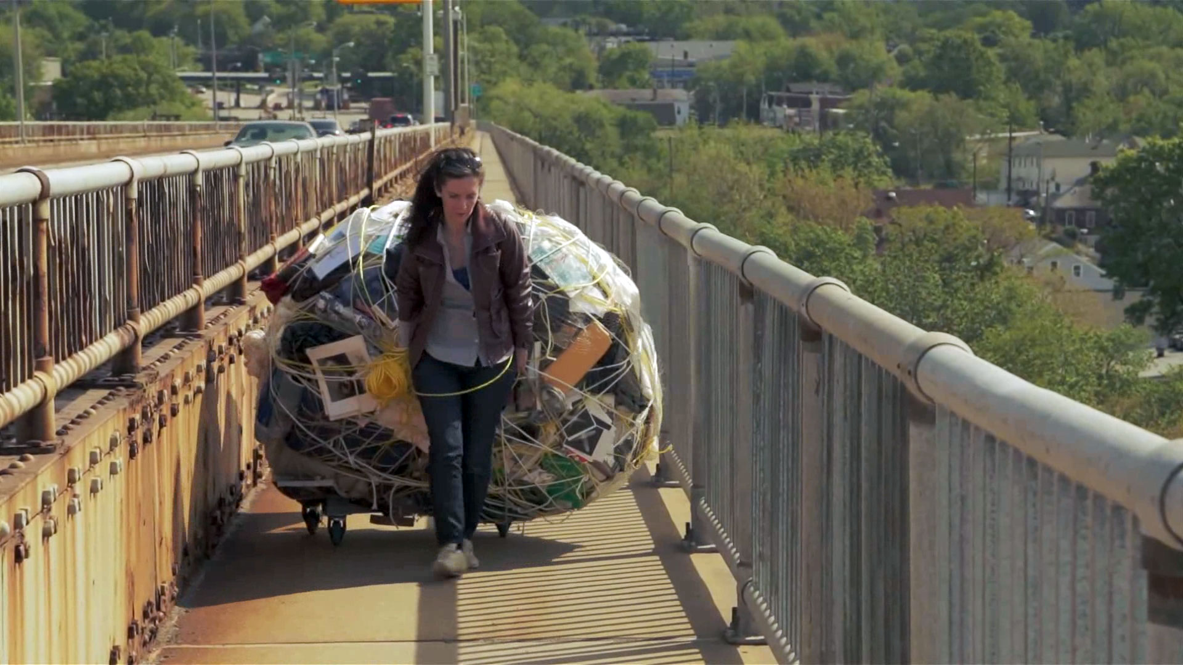
Extraction and Responsibility:
10 minutes
Exploring Ecological Footprinting
through the work of
Mary Mattingly
Notes:
Mary Mattingly investigates and critiques her personal consumer footprint through sculptures, performances, and photographs.
Image source: http://www.art21.org/newyorkcloseup/artists/mary-mattingly/
Tell students that today they will be exploring the work of contemporary artist Mary Mattingly and considering human’s responsibility to the environment.
Word Wall (10 minutes): Announce to the class that they will be creating and maintaining a Word Wall. Model the strategy by starting with the three terms on the title slide: extraction, responsibility, ecological footprint (see suggested definitions from the “Word Wall resource sheet”).

Slide 3


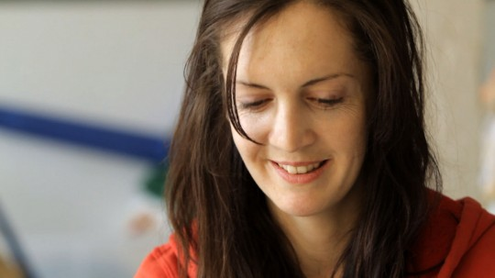
Mary Mattingly
American visual artist living and working in New York
Born in Rockville, Connecticut in 1978
Studied at Parsons School of Design in New York
Received her Bachelor of Fine Arts from Pacific Northwest College of Art in Portland, Oregon
Recipient of a Yale University School of Art Fellowship
Notes:
Image source: http://www.art21.org/newyorkcloseup/artists/mary-mattingly/

Slide 4
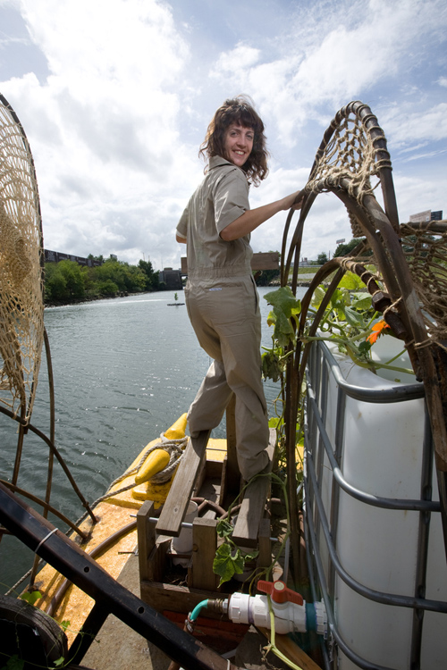
Mattingly’s work
investigates and critiques her personal consumer footprint through sculptures, performances, and photographs
Notes:
Pause to explain the terms “critique” and “consumer footprint.”
Image source: https://roughcopymag.wordpress.com/2010/02/17/artist-interview-mary-mattingly/

Slide 5
Drum (2014)
“I needed to turn my useful objects into something useless so wrapped them into boulders to show their mass and obstruction. I decided to live my life from now on without them, in their place I’m faced with sculptures of excess that are very Sisyphean.”
Notes:
Text at the bottom of the work:
Script beneath the artwork: “I needed to turn my useful objects into something useless so wrapped them into boulders to show their mass and obstruction. I decided to live my life from now on without them, in their place I’m faced with sculptures of excess that are very Sisyphean.”
Explain the Greek myth of Sisyphus.
Image source: http://www.marymattingly.com/html/MATTINGLYBlockades_02.html

Slide 6
A Week Without Speaking
(2012)
Notes:
Image source: http://www.marymattingly.com/html/MATTINGLYHouseUniverse8.html
In this piece, For a Week Without Speaking (2012), the artist is shown rowing in quietly rippling waters, her bundled possessions atop wooden shafts, on a water way in the forest.

Slide 7
Nine Chains to the Moon (2013)
“You're faced with it in a way that's very different from being faced with your possessions in their individual forms because when you bundle them, they're oppressive.”
Notes:
Image source: https://paddle8.com/work/mary-mattingly/88723-nine-chains-to-the-moon
Quote from Mary Mattingly about the work: “Using the form of the bundle, I wanted to show literally how big it was—sort of emphasizing the magnitude of how much we depend on material things. You're faced with it in a way that's very different from being faced with your possessions in their individual forms because when you bundle them, they're oppressive.”

Slide 8
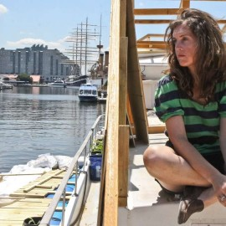
10 minutes
Reflect & Respond
“Maybe we need art more today because we’re in a world with so many mass produced things.”
--- Mary Mattingly

Slide 9
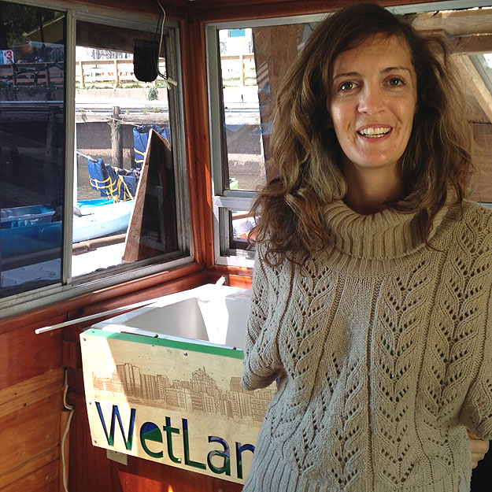
Day 2
Extraction and Responsibility:
Exploring Ecological Footprinting through the work of Mary Mattingly

Slide 10

Think about:
What does it mean to “throw something away”?
Where is “away”?
Where does our garbage go?
Notes:
Allow students a minute or two to reflect individually, then ask for volunteers to answer the question. Engage the class in a brief discussion.
Explain to students that some cities charge people per trash can that they put out for collection. Ask: is that fair? Why or why not? Tell students that today they will continue to reflect on the work of contemporary Mary Mattingly and reflect on individuals’ responsibility for the objects they consume and throw away.

Slide 11
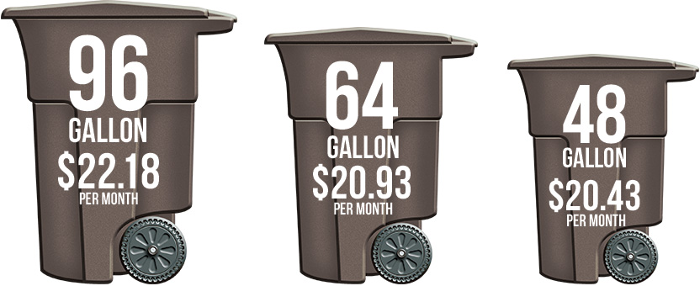
Some cities charge by the amount of trash you discard.
Is this fair?
Why or why not?
Example: City of San Antonio, TX

Slide 12
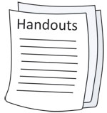
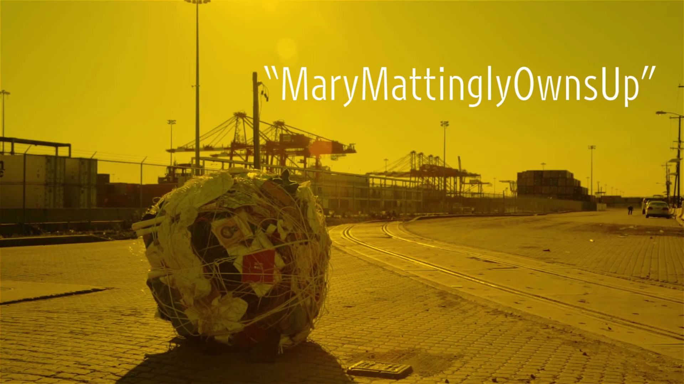
Own-It
(2013-ongoing)
Viewing Guide
for
Mary Mattingly Owns Up
Notes:
Web access: http://www.art21.org/newyorkcloseup/films/mary-mattingly-owns-up
In this film, Mary Mattingly transforms personal belongings into sculptural forms that she later incorporates into photographs and performative actions. Experimenting with living in her Greenpoint studio space, Mattingly is determined to live with just the bare essentials. Over several months, she undertakes a process of recording every object she owns and tracing the history of each of her belongings—how it came into her life, its distribution via complex global supply chains, as well as where the raw materials for its manufacture was sourced—before uploading a digital version of each object to her website OWN-IT.US for others to access. Throughout this process, she takes stock of the environmental and societal impact of her personal consumption, wondering if “maybe we need art more today because we’re in a world with so many mass produced things.” Mattingly aggregates all of her personal belongings into boulder-like sculptural bundles, held together with rope, so that she is able to roll and drag them. She’s photographed walking the sculpture Fill (Obstruct) (2013) across the Bayonne Bridge, from Staten Island to New Jersey, and to the Port of New York New Jersey—symbolically returning her personal belongings to the place where they entered the East Coast. “It’s kind of really incredibly Sisyphean in a way,” says Mattingly about her actions, eventually attracting the attention of the Port Authority Police and Homeland Security who surveil the port.

Slide 13

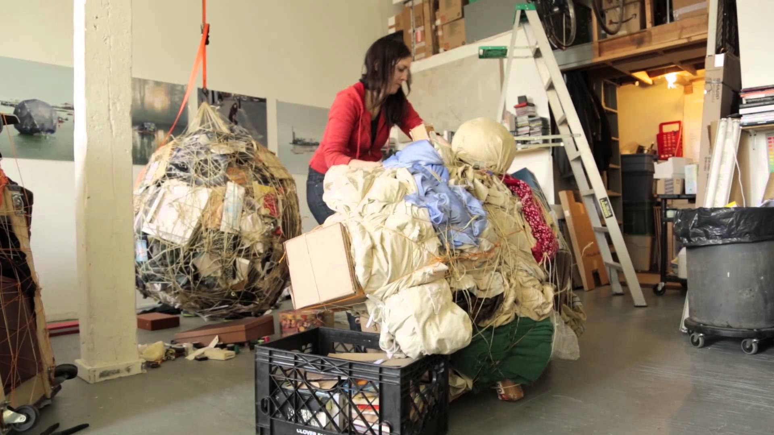
Video
3 ½ minutes
As you view, consider:
Do objects come with responsibility?
http://www.art21.org/newyorkcloseup/films/mary-mattingly-owns-up/
Notes:
Access the 9-minute video, Mary Mattingly Owns Up (http://www.art21.org/newyorkcloseup/films/mary-mattingly-owns-up/). Although the video is nine minutes long, you will just use the first 3:26 minutes in class.) Distribute the Viewing Guide for Mary Mattingly Owns Up. Review the questions with the students, clarifying any queries they might have. Allow students to review the Word Bank before viewing (you can also review the list as a class). Ask students to view and listen carefully, answering the questions in writing on the Viewing Guide as they view the video clip. Pause the video periodically so that students have an opportunity to write down their responses on their Viewing Guides.
Image source: https://i.ytimg.com/vi/gujH5oYmHcY/maxresdefault.jpg

Slide 14

Research!
Documenting Your Personal Objects
10 minutes
http://own-it.us
My Possessions
Notes:
Have students visit Mary Mattingly’s web site, “Own-It.US” (http://own-it.us) [alternately, the web site can be accessed by the teacher and projected in the classroom for all to see]. Have students peruse Mattingly’s possessions. Photocopy and distribute the “My Possessions” handout. Ask them to make a list documenting their own possessions, reflecting on objects’ origins, purpose, and likely future [alternately, students may be allowed to photographically document their list]. Although this assignment will be completed as homework, allow the students to document one or two items (have them look in their pockets, purses, and backpacks) while they are in class to ensure they understand the process.
Image source: http://www.123rf.com/photo_15115203_research-word-in-magnifying-glass--background-medical.html

Slide 15
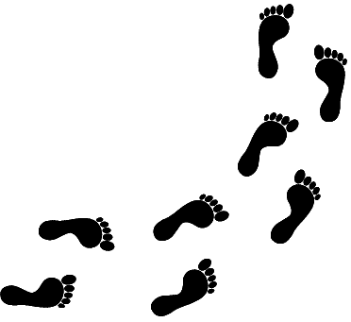
Think-Pair-Share
10 minutes
Mary Mattingly says all of us are “extractive beings.” To extract means to pull out or take.
  How are humans “extractive beings”?
There are some people, companies, and nations that use more of the earth's resources than others.
  Should they be required to pay more for these resources?
  Should they be required to clean the environment?
Notes:
Before commencing activity, refer to the Word Wall for the definitions of some of the terms used in the questions.
Ask students to first reflect individually on the questions posed, then discuss in pairs, and finally as a whole group.

Slide 16
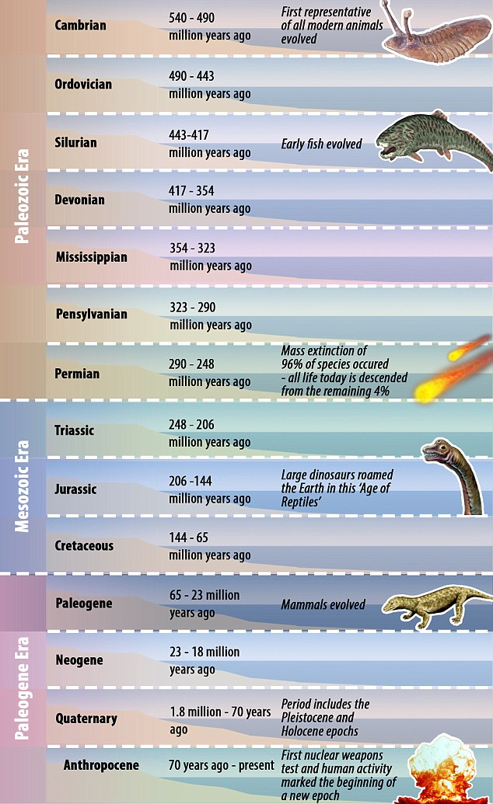
Whenever the earth's surface experiences a major change, geologists declare a new epoch. Because of all the recent changes on the planet made by humans, some geologists have called for a new epoch, called the Anthropocene (humans + geologic period).
Do you agree that we need the creation of this new epoch?
Notes:
Do you agree with the Anthropocene being added as an epoch in human history? Why? Explain your reasoning.
The name of which means the human epoch - was proposed by Nobel Prize-winning atmospheric chemist Paul Crutzen, circa 2000.

Slide 17

Write!
10 minutes
When you are buying something, do you ever think about how it might affect the earth? Give an example.
  If no, explain why not.
  If yes, in what way(s)?

Slide 18

Global Footprint Network: http://www.footprintnetwork.org/en/index.php/GFN/page/calculators/
World Wildlife Fund: http://footprint.wwf.org.uk/
The Nature Conservancy: http://www.nature.org/greenliving/carboncalculator/
Earth Day Network: http://www.earthday.org/take-action/footprint-calculator/
Happy Planet Index: http://www.happyplanetindex.org/

