Slide 1
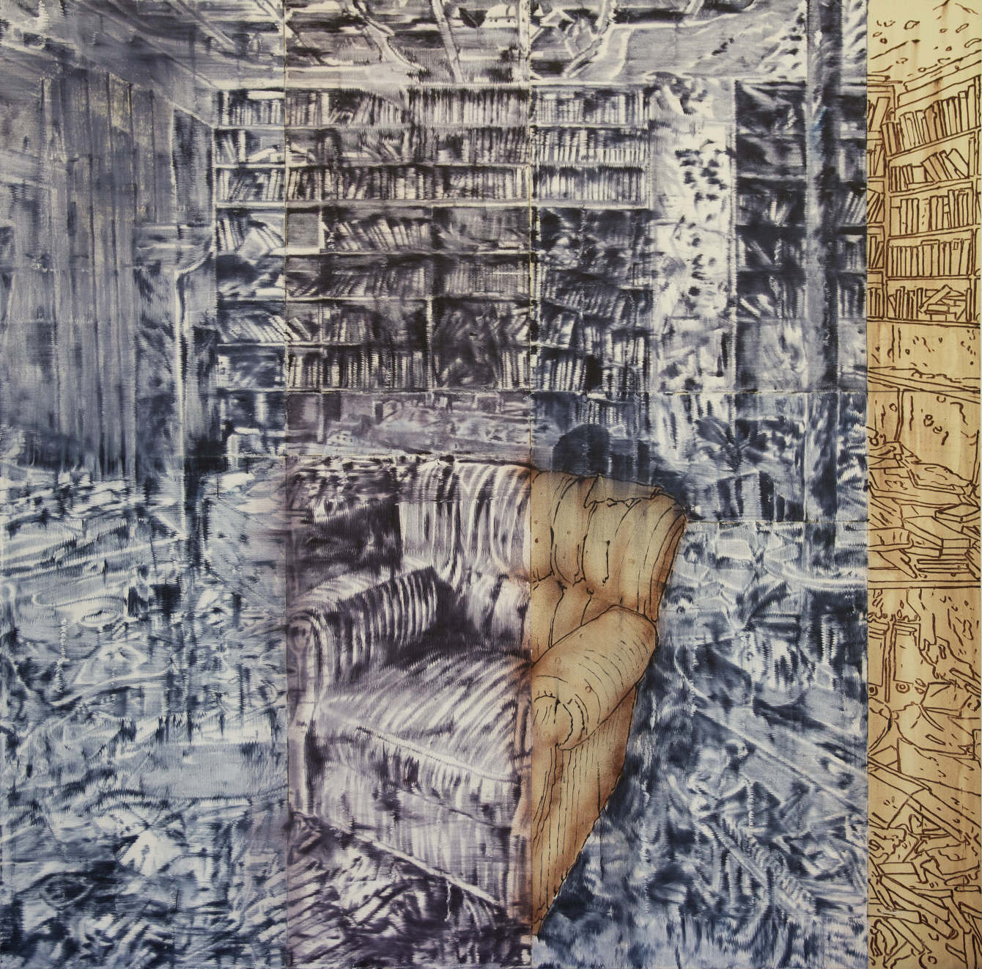
Notes:
Provide students with 1-2 minutes to view the image silently. Then, begin analysis and discussion (having students build on each other’s observations) by asking:
What’s going on in this painting?
What do you see that makes you say that?
What more can we find?
Probe further by asking:
Where is the setting of this painting?
Why do you think this setting is portrayed in this manner?
Debrief the discussion of the painting by telling students that New York-based artist, Jorge Tacla, created the painting. It is part of a series titled Sign of Abandonment (2018).
Sign of Abandonment 30, 2018
Image: https://jorgetacla.com/ABOUT

Slide 2
Sign of Abandonment
What message do you think the artist trying to convey with the title of the series, “Sign of Abandonment”?
Why do you think the artist has chosen this image to include in the series?
Notes:
Ask students:
What message do you think the artist is trying to convey with the title of the series, “Sign of Abandonment”?
Why do you think the artist has chosen this image to include in the series?
Engage students in a brief discussion predicting the intent behind the artist’s work prior to advancing to the title slide.

Slide 3
Jorge Tacla
Sign of Abandonment
Notes:
Review the description of Tacla’s project with students.
Say: Through his ghost-like paintings, Tacla blurs the formal boundaries between abstraction and representation to present a damaged view of the world. His paintings explore the invisible structures and systems at work in society. Today we will discuss Tacla’s work, Sign of Abandonment 34 (Homs, All that is Solid Melts Into Air) and the Syrian conflict that has led to the destruction of the city of Homs represented in the painting.
If desired, reverse back to slides 1 & 2 to review students prediction’s of the artist’s meaning.
Image by Ari Maldonado, retrieved from http://lawrenceweschler.com/library/article/in-conversation-with-chilean-artist-jorge-tacla

Slide 4
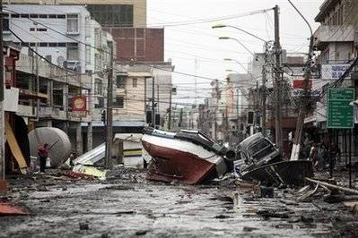
Jorge Tacla
Born in Chile (1958)
Studied at Escuela de Bellas Artes, Universidad de Chile
Experienced 1985 Chile earthquake
Tacla: “After the 1985 earthquake in Chile, I was able to see, through a tragedy, the weakness behind constructions that appear indestructible.”
Notes:
The 1985 earthquake had a magnitude of 8.0 on the Richter scale. It left 177 people dead, 2,575 injured, 85,358 houses destroyed, and about a million people homeless.

Slide 5
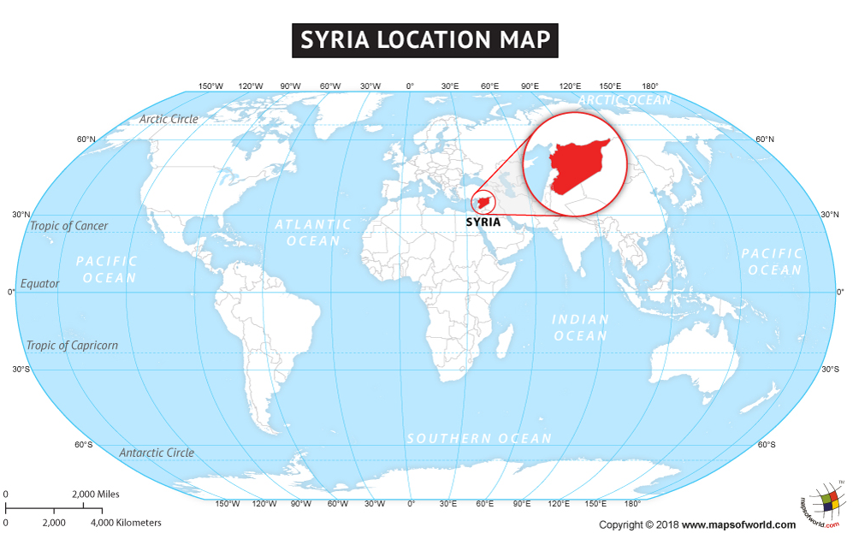
What do you know or what have you heard about the crisis in Syria?
Notes:
Ask students:
What do you know or what have you heard about the crisis in Syria?
Provide an opportunity for students to share their responses with the class.
Show students the video: “Understanding the Complexities of Syria’s Civil War” (2: 21)
https://www.youtube.com/watch?v=FLHt5IQtI40
This video provides a succinct explanation of the conflict in Syria.
Image source: https://www.mapsofworld.com/syria/maps/syria-location-map.jpg

Slide 6
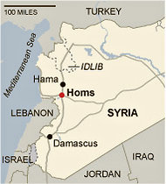
Homs: ‘Capital of the Revolution’
Syria’s third largest city
History stretches back to 1st Millennium BC
An important trading post on route from the Mediterranean Sea to India and China in the Roman era
Notes:
Image: NY Times, retrieved from https://www.nytimes.com/2011/10/02/world/middleeast/homs-syria-spirals-down-toward-civil-war.html

Slide 7
Homs: ‘Capital of the Revolution’
Homs residents began protesting the Assad government in 2011
Opposition supporters took up arms when met with tanks sent to suppress dissent
By 2012, the opposition held 20% of Homs
Notes:
Image: BBC, retrieved from https://www.bbc.com/news/world-middle-east-15625642#

Slide 8
Homs: ‘Capital of the Revolution’
Old City of Homs: under siege between 2012 and 2014
3,000 civilians were trapped without access to food and medical supplies and under repeated bombardment by artillery and aircraft
Rebels agreed to withdraw following UN intervention

Slide 9
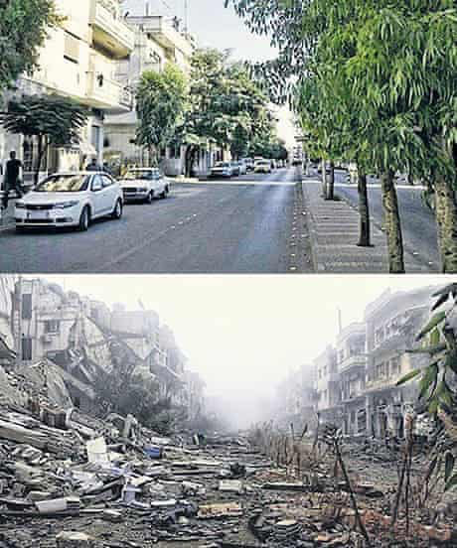
Homs, in 2011
Homs, in 2014
Notes:
Image: The Guardian, retrieved from https://www.theguardian.com/world/2014/jan/26/syria-heritage-in-ruins-before-and-after-pictures

Slide 10
Homs: Reading Questions
Describe the living conditions of the Bairuty family.
In what ways has the conflict in Syria impacted the Bairuty family?
Is the Bairuty family hopeful about the future of Homs? Explain.
Notes:
Distribute a copy of the reading to each student. Encourage students to highlight important passages and significant vocabulary as they read.
Comprehension Check and Discussion:
After students have completed the reading and answered the questions, have them debrief either in small groups or as a whole class, comparing their responses with those of others.
Ask for volunteers to share their answers to the final question:
Is the Bairuty family hopeful about the future of Homs? Explain.
Extend the discussion by asking students:
What do you think the future holds for the city of Homs? Explain.

Slide 11
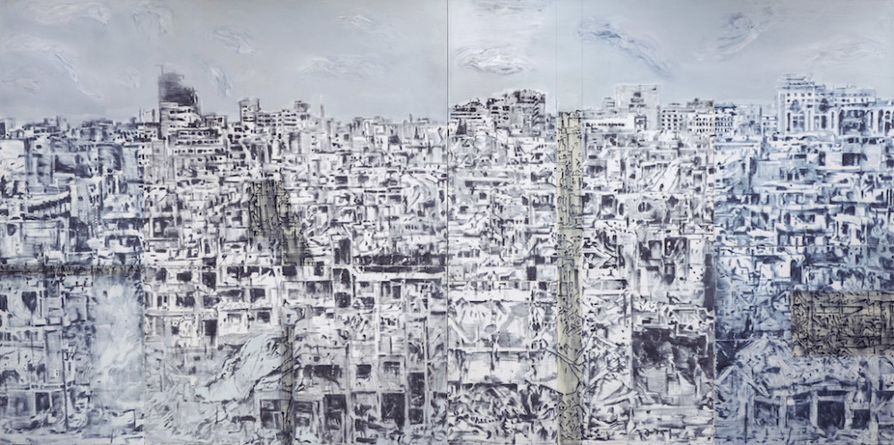
Notes:
In this painting, Taclas presents the city of Homs. Tacla describes Homs as a city about to disappear and his paintings capture the moment before.
“Chilean artist Jorge Tacla uses oil paint and cold wax on his 26-foot-long canvas to eerily evoke an entire cityscape reduced to hollowed-out buildings. The expanse of abandoned high-rises resembles the caves of the Puebla Indians who carved out dwellings in the sides of cliffs centuries ago.” (J. Milani, 2019, Tampa Bay Times)
Ask students:
What do you notice about this picture that is different from the first painting we viewed in this lesson? What is similar?
Why do you think the artist has chosen to include both paintings in the series titled “Signs of Abandonment”?
Sign of Abandonment, 20
Image credit: https://jorgetacla.com/SIGN-OF-ABANDONMENT-SERIES

Slide 12
Notes:
Tacla describes his works as creating a “visible memory of contemporary history”. It is a quadriptych (a picture or series of pictures painted on four panels).
Ask students:
In what ways is the destruction of the city of Homs important to our understanding of history?
Why do you think Tacla chooses to portray destruction using his ghost-like method of painting? Explain your response
Sign of Abandonment 34, 2018
Image: https://jorgetacla.com/ABOUT

Slide 13
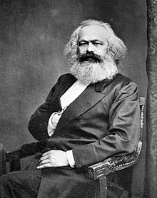
All That is Solid Melts Into Air
“All that is solid melts into air, all that is holy is profaned, and man is last compelled to face with sober senses his real conditions of life, and his relations with his kind.”
- Karl Marx
Notes:
Ask students to write paragraph responding to the following questions:
In what ways does the quote by Karl Marx relate to the work of Jorge Tacla?
What message might Tacla be trying to convey about man’s ‘relations with his kind’?

