Slide 1
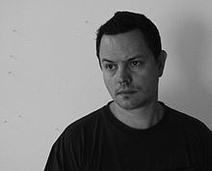
Robert Lazzarini
“Return of the Real”

Slide 2
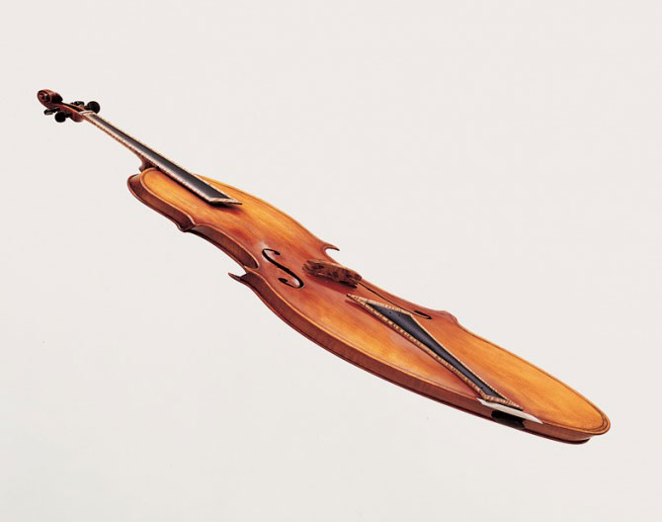
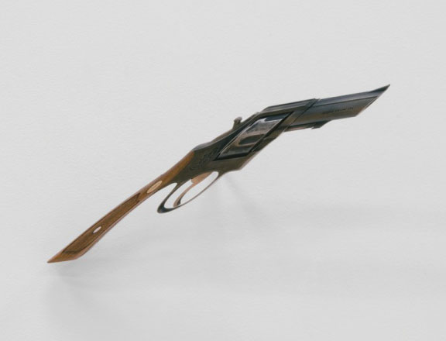
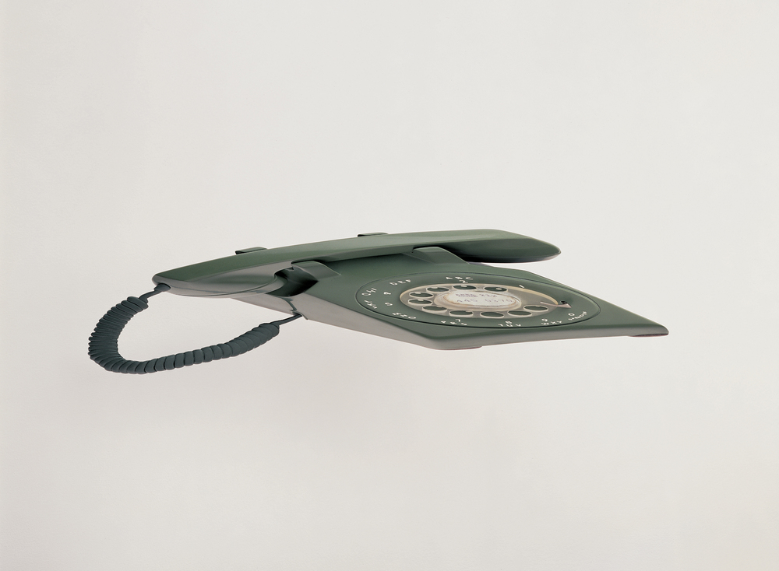
Name each of these objects…
Notes:
Each image will come in one at a time. After students name each object [violin, gun, and telephone], ask:
What do they all have in common? [they are all distorted]
What materials do you think were used to create these objects?
Why do you think they were distorted?
Advance to the next slide to reveal the titles of each art work and the materials from which they were constructed.
Image source of violin and gun: http://www.museomagazine.com/ROBERT-LAZZARINI
Image source of telephone: http://www.robertlazzarini.com/studio-objects

Slide 3
Violin (1997); maple, spruce, ebony, bone
Gun (2008); metal, wood
Rotary phone (2000); plastic, metal, rubber, paper
Notes:
Ask students: How do you think these distortions were made?
Explain that although the images might look they are digitally manipulated or Photoshopped, in reality they are 3D sculptures that were intentionally skewed by the artist, Robert Lazzarini.
Lazzarini is known for taking ordinary objects and creating sculptures that are so distorted that the visual, physical experience challenges perception and disrupts normal visual recognition. He constructs his sculptures out of the same materials as their real world counterparts.
The three-dimensional nature of Lazzarini’s work means that the viewer is encouraged to walk around the sculpture to examine the piece from all angles.
Advance to the next slide to show Gun next to the artist’s hand for perspective.
Image source: http://www.museomagazine.com/ROBERT-LAZZARINI

Slide 4
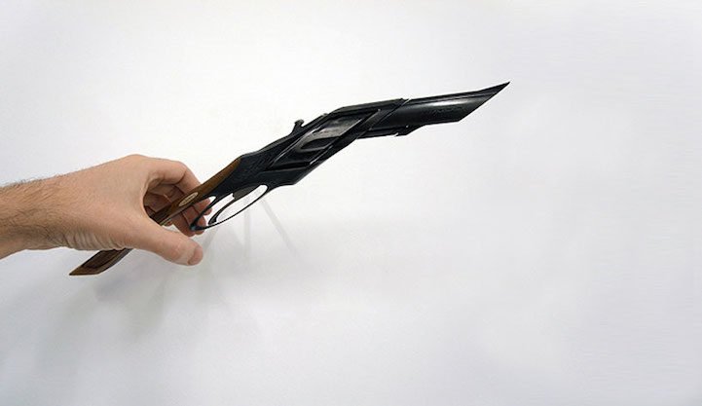
Notes:
This photo of Gun, taken with the artist’s hand in the frame, provides perspective on how it looks like in real life.

Slide 5
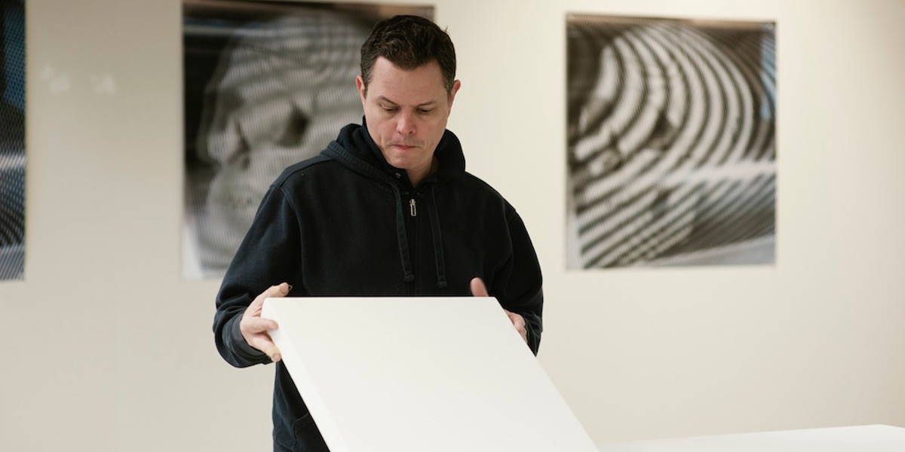
Robert Lazzarini: Master of Sculptural Illusion

Slide 6
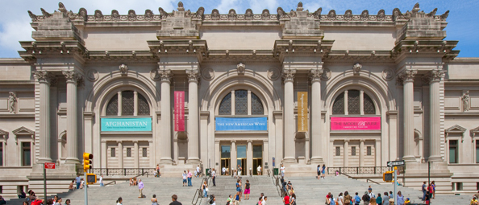
Brief Biography
Born: September 22, 1965 in Denville, New Jersey
Introduced to art history on family trips to the Metropolitan Museum of Art in New York City
Later worked for 5 years in the Met’s bookshop
Education: Bachelor of Fine Arts degree in sculpture, Parsons School of Design & the School of Visual Arts
Metropolitan Museum of Art
Notes:
Image source: https://www.nyc-arts.org/organizations/4/metropolitan-museum-of-art

Slide 7
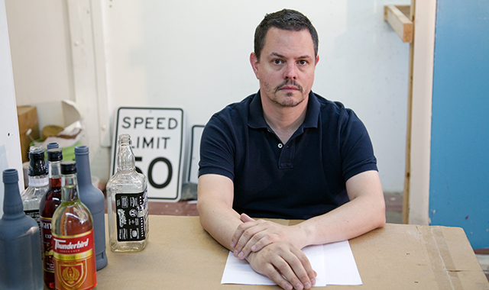
“A concern of mine has always been the idea of the historicity of the object. Thinking about the object not as this new or ideal thing, but as something that’s lived in the world and has been affected.”
Robert Lazzarini
Notes:
For Lazzarini, the history of the object, indicated by the marks of time and wear, relates directly to the people who used it, sometimes violently, others casually. As he explains: “A concern of mine has always been the idea of the historicity of the object. Thinking about the object not as this new or ideal thing, but as something that’s lived in the world and has been affected.”
Image source: https://www.blouinartinfo.com/news/story/854182/in-the-studio-with-robert-lazzarini-master-of-sculptural

Slide 8
Lazzarini’s process: tradition + technology
Lazzarini selects a familiar object
He makes a digital scan of the object
Using computer-assisted design programs, he transforms the image to two-dimensional distortions
Using mathematical algorithms, he creates full-size three-dimensional models from the electronic files of the drawings
Lazzarini then selects appropriate material that mimic the real object
Finally, he creates the final sculptures, using the same materials and scale as the original object

Slide 9

Analysis and Reflection Activity
Consider each of the following art works and record your thoughts on your worksheet…
Notes:
Distribute to each student a copy of the “Analysis & Reflection Worksheet” and direct students to fill in the handout as they consider each of the following 9 images.

Slide 10
motel door (kicked-in), 2012
wood, plexiglass and paint, 102 x 70 x 48 inches

Slide 11
chain-link fence (Torn), 2012
steel and pigment, 134 x 276 x 75 inches

Slide 12

Hammers, 2000
oak, steel
13 1/2 x 16 x 12

Slide 13
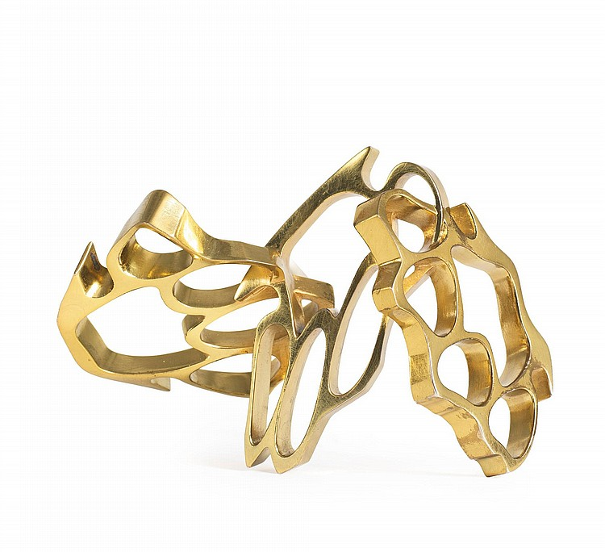
Brass Knuckles, 2010
brass, 5 x 7 x 4 in
Notes:
Image source: https://mymodernmet.com/robert-lazzarini-sculptures/

Slide 14
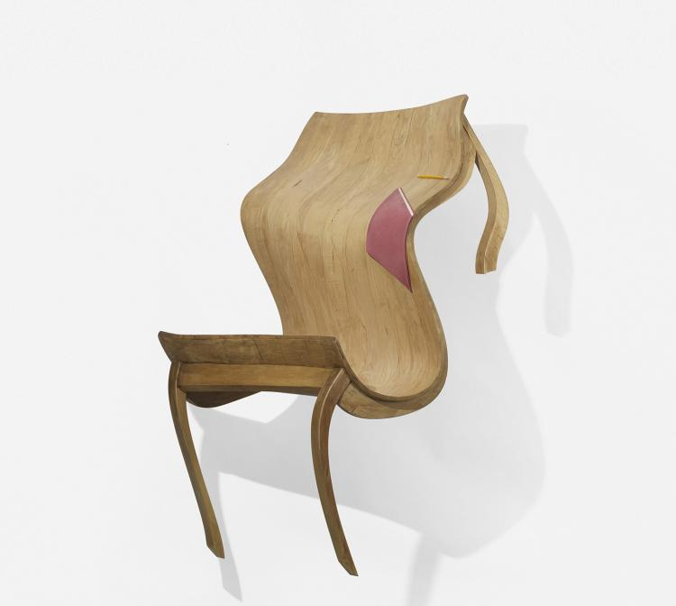
Table, Notebook, and Pencil, 2004
mixed media, wood, pigment
56 X 45 X 41 inches
Notes:
Image source and description: http://www.mintmuseums.org/resources/collection-database/item/2007.96.2/table-notebook-and-pencil/
Robert Lazzarinis sculptures are at once strikingly
recognizable yet eerily unfamiliar. He makes use of planar
distortion and meticulous patinas to create uncanny sculptures
like Table, Notebook, and Pencil. The sculptures seem to
shift and collapse as the viewer moves and changes vantage
pointsthere is never a perspective from which the viewer is
able to see the object as it should ordinarily look. Lazzarini has
developed a unique approach that combines both traditional
and technological methods of sculpture. Beginning with an
image of an ordinary object, in this case a table, Lazzarini
employs computer design programs to digitally alter the image,
then uses the resulting images to create threedimensional
forms via a method of computergenerated modelmaking,
which become the basis for the final lifesized sculptures.

Slide 15
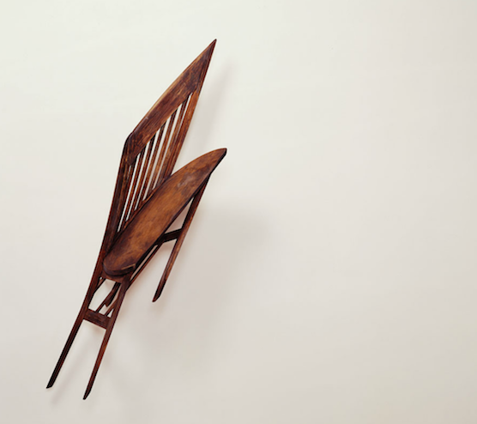
Chair, 2000
maple wood and pigment
54 x 26 x 12 inches
Notes:
Image source: https://mymodernmet.com/robert-lazzarini-sculptures/

Slide 16
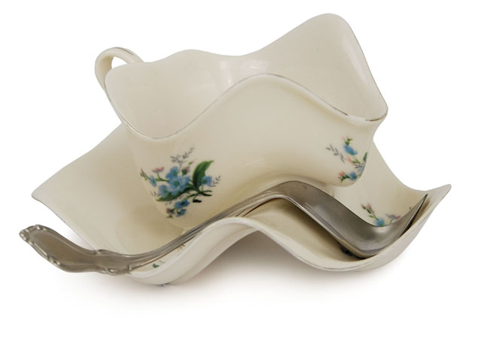
Tempest of a Teacup, 2003
3⅜ x 6½ x 7 inches
Notes:
Image source and description: https://www.moma.org/explore/inside_out/2010/12/05/tempest-of-a-teacup/
Robert Lazzarini. Teacup. 2003
For this project, New York–based artist Robert Lazzarini‘s first experiment in “complex nonlinear distortion,” the artist composited attributes of different cups and saucers to arrive at an archetypal object. He first drew the cup and saucer using three-dimensional modeling software, and then he laser-scanned a well-proportioned spoon and fed the scan directly into his computer. He next applied multiple sine wave patterns along different axes through these virtual objects. You got all that?
After finishing the virtual modeling stage, Lazzarini created a series of rapid prototypes, reproducing the rendering in three-dimensional form. He then hand-finished the prototypes, smoothing the surfaces and sculpting a chip in the rim of the cup to suggest years of use. Designed to be viewed from all angles, Teacup is a playful visual anomaly that leaps out from among everyday items. Lazzarini has lived and worked in New York since the 1980s, and his early interest in art was encouraged by his grandfather—an art teacher—and others in his family, many of whom are members of the scientific community. His work often re-creates and then subverts everyday objects, confounding viewers’ expectations and challenging ideas of perception—and this work is certainly no exception.

Slide 17
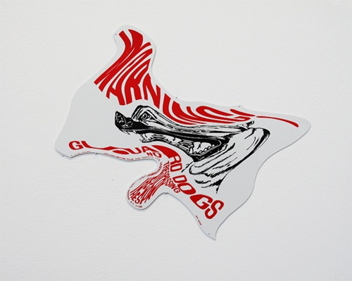
Guard Dog Sign, 2010
Two-color screenprint on epoxy-painted laser-cut aluminum
16 ½ x 14 x 1/16 inches

Slide 18
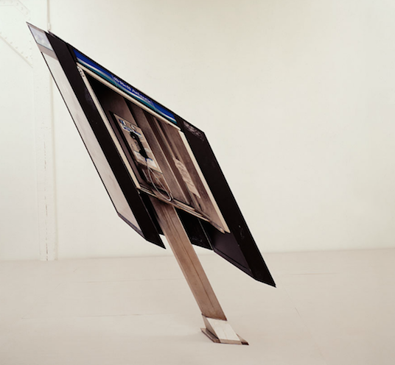
Payphone, 2002
Anodized aluminum, stainless steel, Plexiglass, and silk-screened graphics
Notes:
Image source: https://mymodernmet.com/robert-lazzarini-sculptures/

