Slide 1
Pull (2013)
Notes:
Give students 2-3 minutes to view the image, allowing them to inspect the image close-up to make out individual elements, if they wish.
Ask:
Where is this scene taking place?
Describe the scene.
What is the person doing?
Describe what she is pulling: what is the ball of things made up of?
How is it all held together?
Why do you think she is pulling the ball of things?
What is the artist trying to convey with this work?

Slide 2
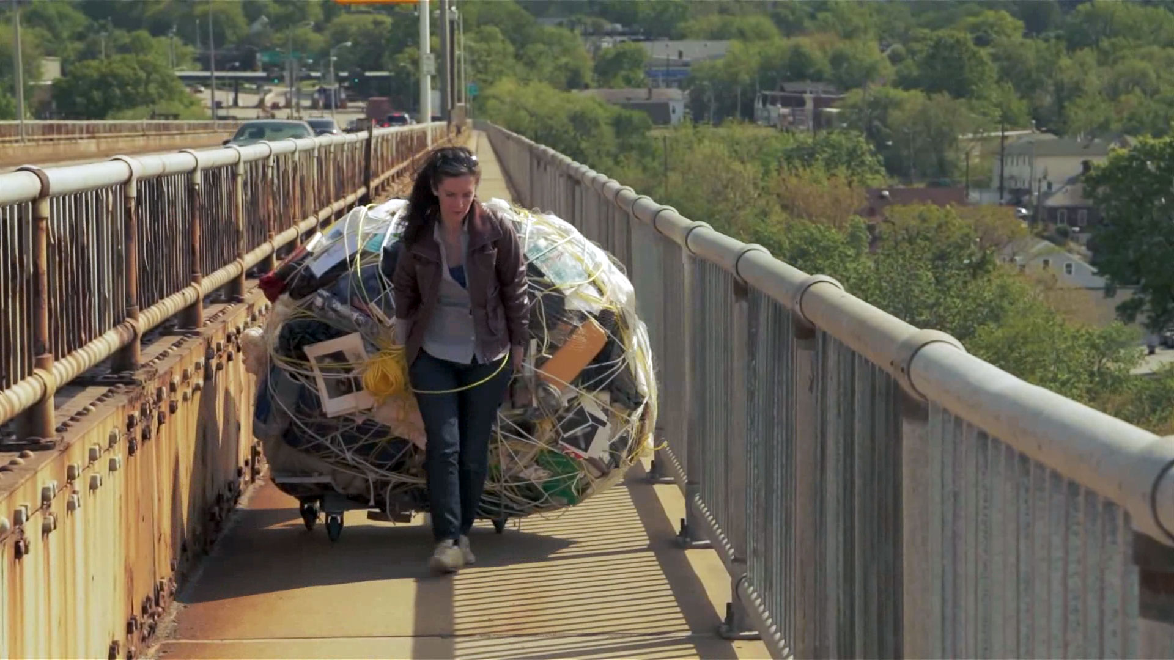
Extraction and Responsibility:
Exploring Ecological Footprinting through the work of
Mary Mattingly
Notes:
Mary Mattingly investigates and critiques her personal consumer footprint through sculptures, performances, and photographs.
Image source: http://www.art21.org/newyorkcloseup/artists/mary-mattingly/

Slide 3
Mary Mattingly
American visual artist living and working in New York
Born in Rockville, Connecticut in 1978
Studied at Parsons School of Design in New York
Received her Bachelor of Fine Arts from Pacific Northwest College of Art in Portland, Oregon
Recipient of a Yale University School of Art Fellowship
Notes:
Image source: http://www.art21.org/newyorkcloseup/artists/mary-mattingly/

Slide 4
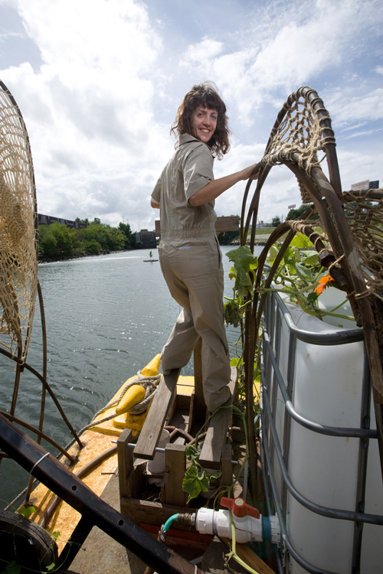
Mattingly’s work
investigates and critiques her personal consumer footprint through sculptures, performances, and photographs
Notes:
Image source: https://roughcopymag.wordpress.com/2010/02/17/artist-interview-mary-mattingly/

Slide 5
Drum (2014)
Notes:
Text:
“I needed to turn my useful objects into something useless so wrapped them into boulders to show their mass and obstruction. I decided to live my life from now on without them, in their place I’m faced with sculptures of excess that are very Sisyphean.”
Image source: http://www.marymattingly.com/html/MATTINGLYBlockades_02.html

Slide 6
Filling Double Negative (2013)
Notes:
Image source: http://www.marymattingly.com/html/MATTINGLYHouseUniverse6.html

Slide 7
A Week Without Speaking (2012)
Notes:
Image source: http://www.marymattingly.com/html/MATTINGLYHouseUniverse8.html

Slide 8
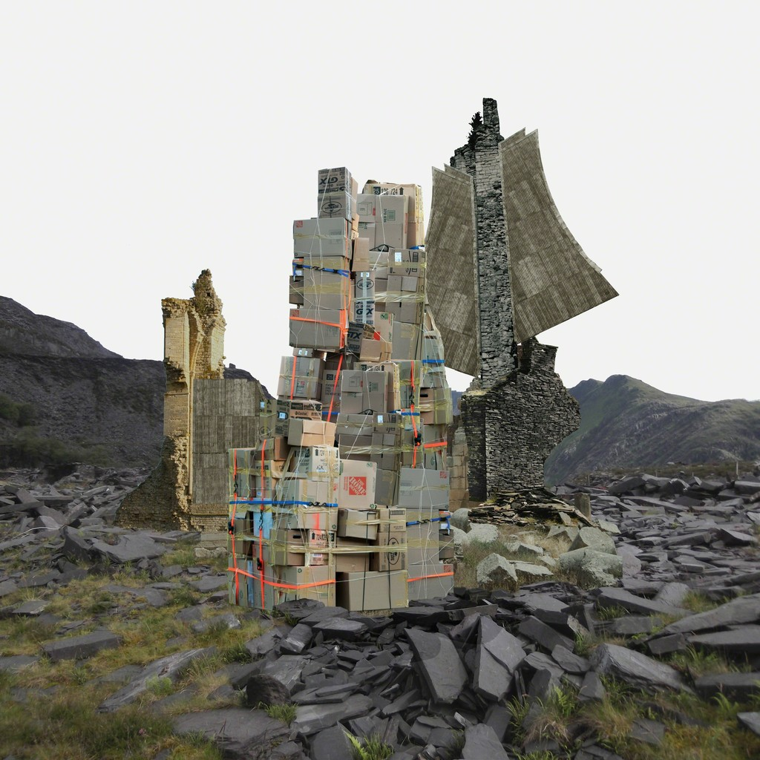
Verse and Universe (2013)
Notes:
Image source: https://www.artsy.net/artwork/mary-mattingly-verse-and-universe

Slide 9
Nine Chains to the Moon (2013)
Notes:
Image source: https://paddle8.com/work/mary-mattingly/88723-nine-chains-to-the-moon
“Using the form of the bundle, I wanted to show literally how big it was—sort of emphasizing the magnitude of how much we depend on material things. You're faced with it in a way that's very different from being faced with your possessions in their individual forms because when you bundle them, they're oppressive.” - Mary Mattingly

Slide 10
The Damned (Titian, again) (2013)
Notes:
Image source: http://www.marymattingly.com/html/MATTINGLYHouseUniverse11.html

Slide 11
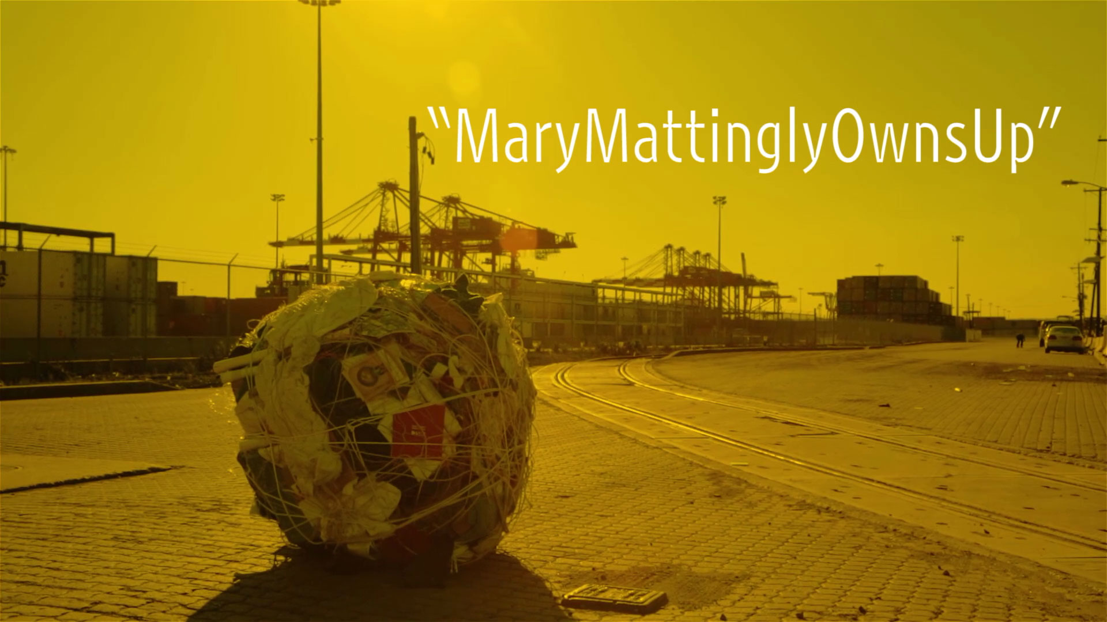
Own-It (2013-ongoing)
Notes:
Web access: http://www.art21.org/newyorkcloseup/films/mary-mattingly-owns-up
In this film, Mary Mattingly transforms personal belongings into sculptural forms that she later incorporates into photographs and performative actions. Experimenting with living in her Greenpoint studio space, Mattingly is determined to live with just the bare essentials. Over several months, she undertakes a process of recording every object she owns and tracing the history of each of her belongings—how it came into her life, its distribution via complex global supply chains, as well as where the raw materials for its manufacture was sourced—before uploading a digital version of each object to her website OWN-IT.US for others to access. Throughout this process, she takes stock of the environmental and societal impact of her personal consumption, wondering if “maybe we need art more today because we’re in a world with so many mass produced things.” Mattingly aggregates all of her personal belongings into boulder-like sculptural bundles, held together with rope, so that she is able to roll and drag them. She’s photographed walking the sculpture Fill (Obstruct) (2013) across the Bayonne Bridge, from Staten Island to New Jersey, and to the Port of New York New Jersey—symbolically returning her personal belongings to the place where they entered the East Coast. “It’s kind of really incredibly Sisyphean in a way,” says Mattingly about her actions, eventually attracting the attention of the Port Authority Police and Homeland Security who surveil the port.

Slide 12
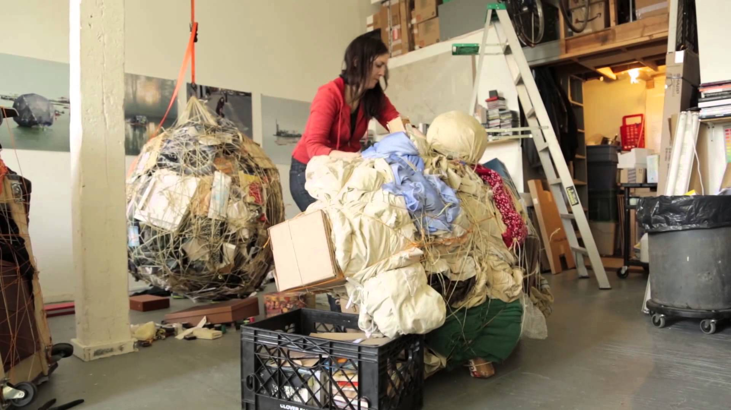
Video
As you view, consider:
Do objects come with responsibility?
Notes:
Access the 9-minute video, Mary Mattingly Owns Up (http://www.art21.org/newyorkcloseup/films/mary-mattingly-owns-up/).
In this film, Mary Mattingly transforms personal belongings into sculptural forms that she later incorporates into photographs and performative actions. Experimenting with living in her Greenpoint studio space, Mattingly is determined to live with just the bare essentials. Over several months, she undertakes a process of recording every object she owns and tracing the history of each of her belongings—how it came into her life, its distribution via complex global supply chains, as well as where the raw materials for its manufacture was sourced—before uploading a digital version of each object to her website OWN-IT.US for others to access. Throughout this process, she takes stock of the environmental and societal impact of her personal consumption, wondering if “maybe we need art more today because we’re in a world with so many mass produced things.” Mattingly aggregates all of her personal belongings into boulder-like sculptural bundles, held together with rope, so that she is able to roll and drag them. She’s photographed walking the sculpture Fill (Obstruct) (2013) across the Bayonne Bridge, from Staten Island to New Jersey, and to the Port of New York New Jersey—symbolically returning her personal belongings to the place where they entered the East Coast. “It’s kind of really incredibly Sisyphean in a way,” says Mattingly about her actions, eventually attracting the attention of the Port Authority Police and Homeland Security who surveil the port.
Image source: https://i.ytimg.com/vi/gujH5oYmHcY/maxresdefault.jpg

Slide 13
"We're probably doomed as humans if we don't start thinking in a posthuman way."
--- Mary Mattingly
Notes:
“Posthuman”: When bioscience and medical technology propel people beyond the old human limits to creatively problem-solve.
CLOSURE: Write these questions on the board, asking students to discuss first in pairs and then as a whole group:
Do you agree with the Anthropocene being added as an epoch in human history? Why? Explain your reasoning.
What does it mean to be an “extractive being”?
Should countries with high ecological footprints be required to invest in environmental clean-up efforts?
Should people with higher ecological footprints be required to pay an “ecological tax”?
Do you feel personally responsible for objects you acquire in your life?

