Slide 1
Life in the City of Darkness
Exploring Kowloon Walled City through the artwork of David Claerbout

Slide 2
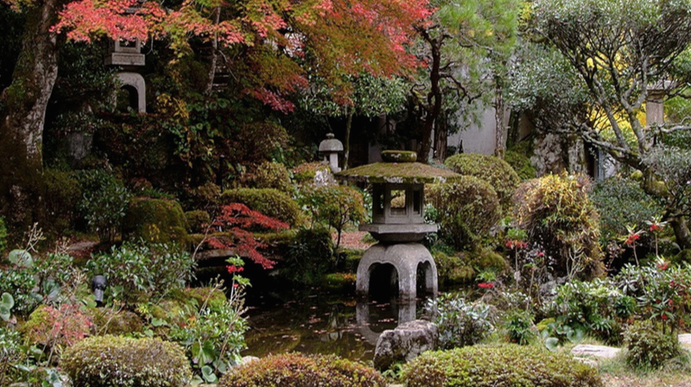

Slide 3
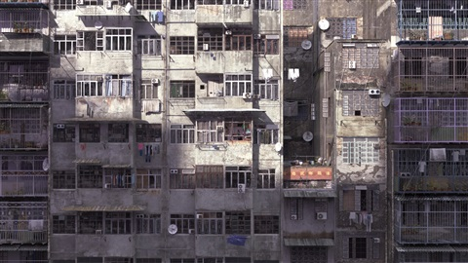

Slide 4
Compare and Contrast
What similarities and differences do you notice between the two physical spaces?

Slide 5
David Claerbout
Works in photography, video, sound, drawing and digital arts
Best known for large-scale video installations
Much of his work blends and overlaps with photography and film
Notes:
Information repeated from introductory lesson as a brief overview and/or refresher

Slide 6
Radio Piece (Hong Kong), 2015
Notes:
Radio Piece (Hong Kong) is an audiovisual installation that includes an uninterrupted backtracking camera, smoothly moving from one type of space into another, moving from a Zen garden, to a cramped apartment, to the walled walled city of Kowloon.
Move through the slides depicting stills of the video and if time permits, show students a video of the installation in progress: https://vimeo.com/129774604

Slide 7
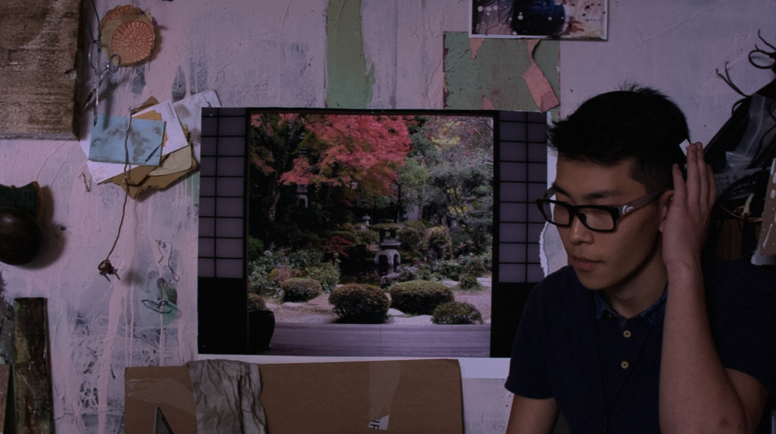
Radio Piece (Hong Kong), 2015
Notes:
Radio Piece (Hong Kong) is an audiovisual installation that includes an uninterrupted backtracking camera, smoothly moving from one type of space into another, moving from a Zen garden, to a cramped apartment, to the walled walled city of Kowloon.
Move through the slides depicting stills of the video and if time permits, show students a video of the installation in progress: https://vimeo.com/129774604

Slide 8
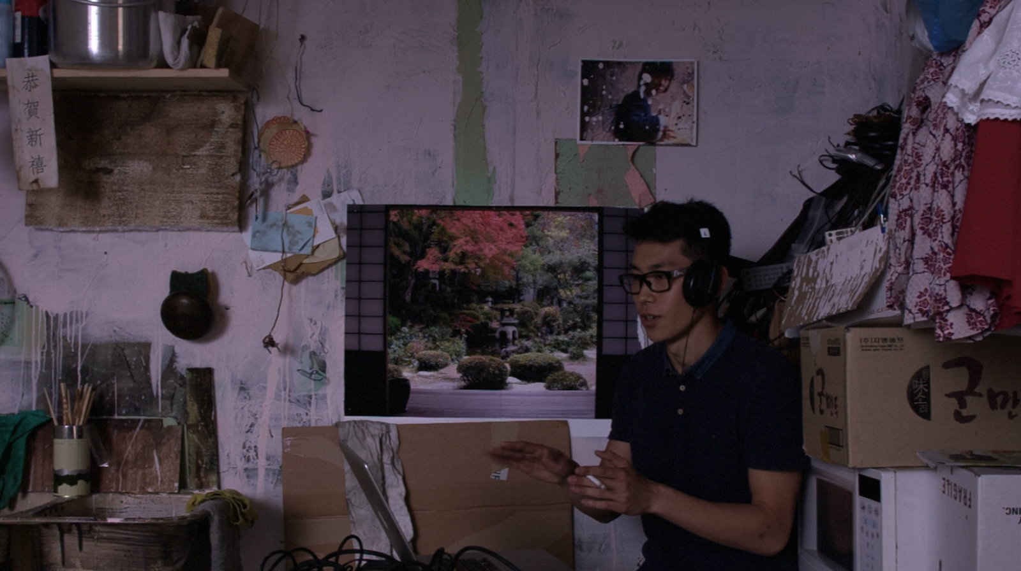
Radio Piece (Hong Kong), 2015
Notes:
Radio Piece (Hong Kong) is an audiovisual installation that includes an uninterrupted backtracking camera, smoothly moving from one type of space into another, moving from a Zen garden, to a cramped apartment, to the walled walled city of Kowloon.
Move through the slides depicting stills of the video and if time permits, show students a video of the installation in progress: https://vimeo.com/129774604

Slide 9
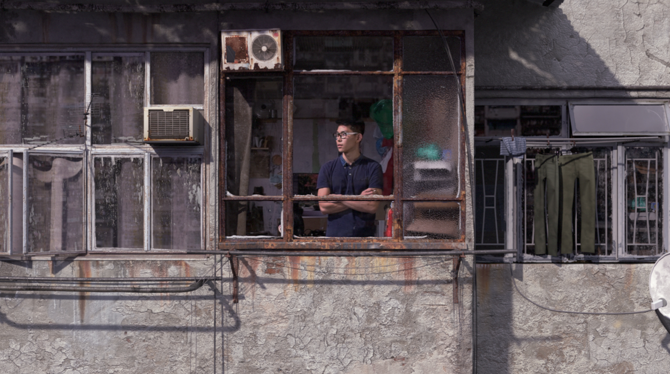
Radio Piece (Hong Kong), 2015
Notes:
Radio Piece (Hong Kong) is an audiovisual installation that includes an uninterrupted backtracking camera, smoothly moving from one type of space into another, moving from a Zen garden, to a cramped apartment, to the walled walled city of Kowloon.
Move through the slides depicting stills of the video and if time permits, show students a video of the installation in progress: https://vimeo.com/129774604

Slide 10
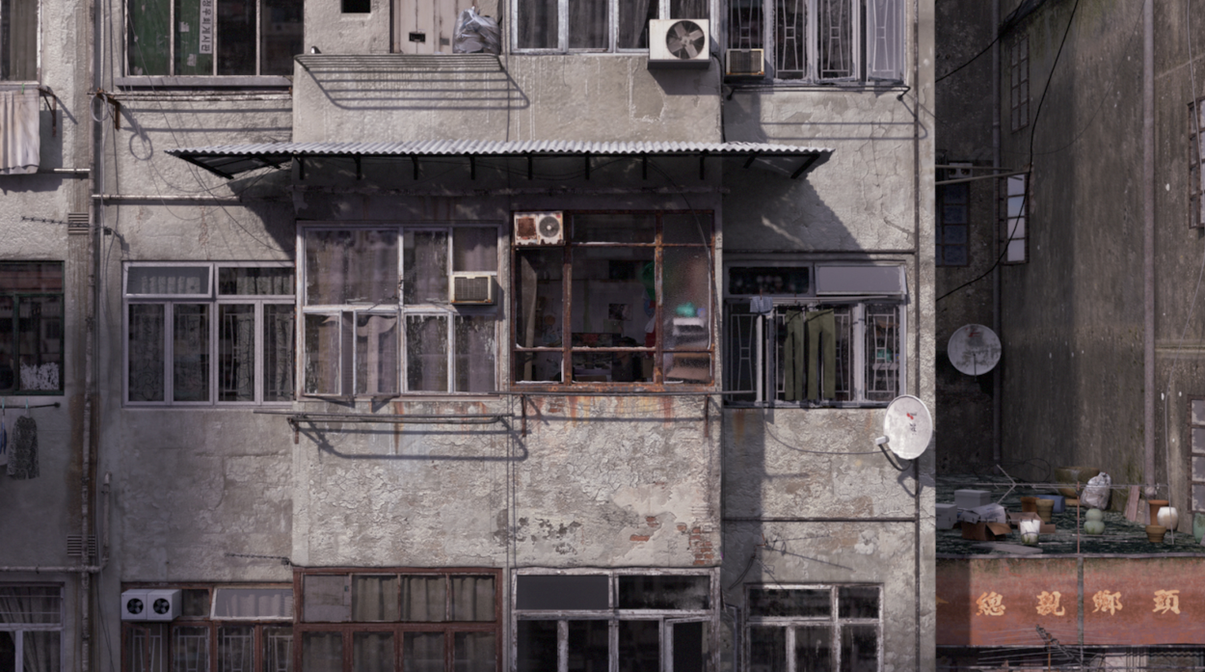
Radio Piece (Hong Kong), 2015
Notes:
Radio Piece (Hong Kong) is an audiovisual installation that includes an uninterrupted backtracking camera, smoothly moving from one type of space into another, moving from a Zen garden, to a cramped apartment, to the walled walled city of Kowloon.
Move through the slides depicting stills of the video and if time permits, show students a video of the installation in progress: https://vimeo.com/129774604

Slide 11
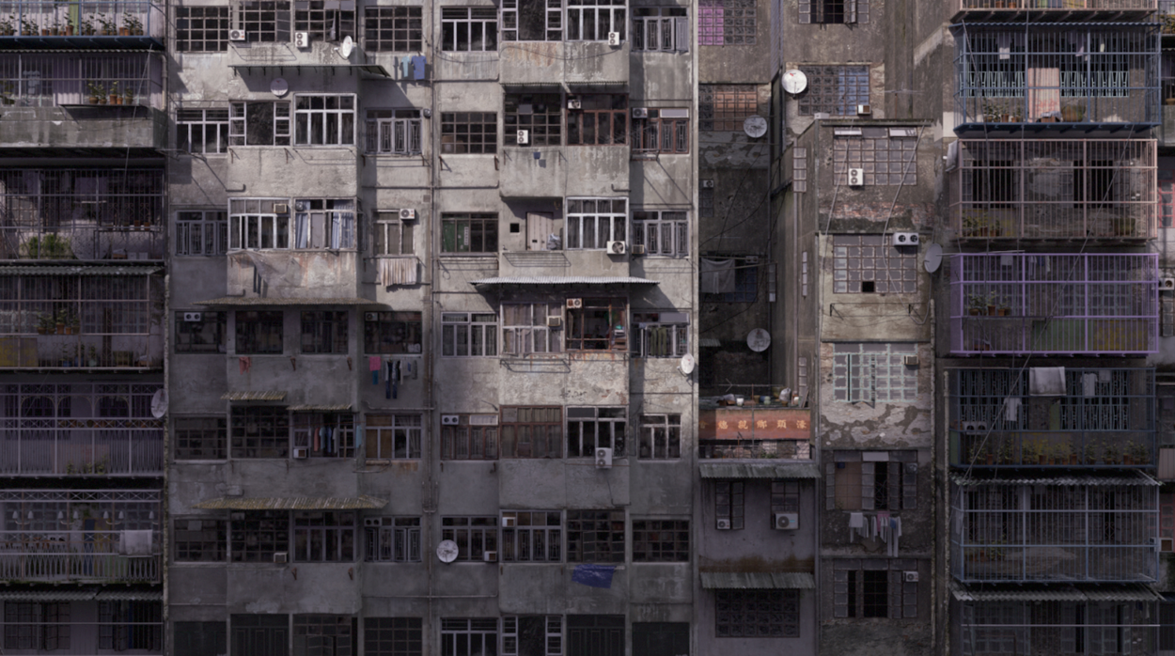
Radio Piece (Hong Kong), 2015
Notes:
Radio Piece (Hong Kong) is an audiovisual installation that includes an uninterrupted backtracking camera, smoothly moving from one type of space into another, moving from a Zen garden, to a cramped apartment, to the walled walled city of Kowloon.
Move through the slides depicting stills of the video and if time permits, show students a video of the installation in progress: https://vimeo.com/129774604

Slide 12
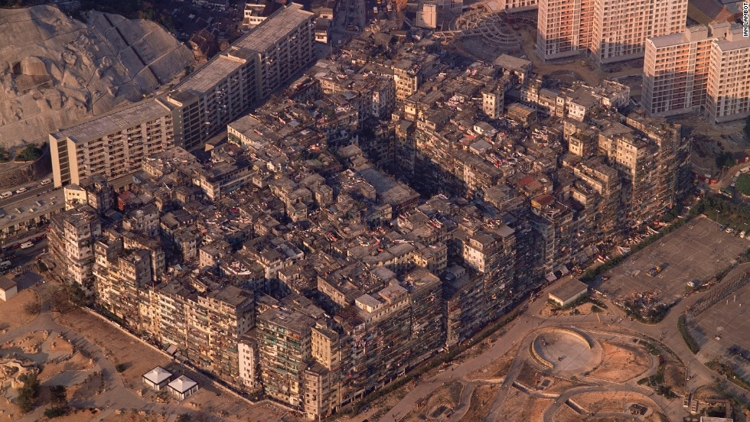
Kowloon Walled City
Notes:
As students view the totality of the city read the following facts aloud. The walled city at its peak, contained:
14 stories
33,000 people
8,000 homes
1,000 businesses
All in under 7 acres, or 2.8 hectares (less than 3 American football fields or approximately one city block). The Kowloon walled city was the densest place on earth up until its demolition.

Slide 13
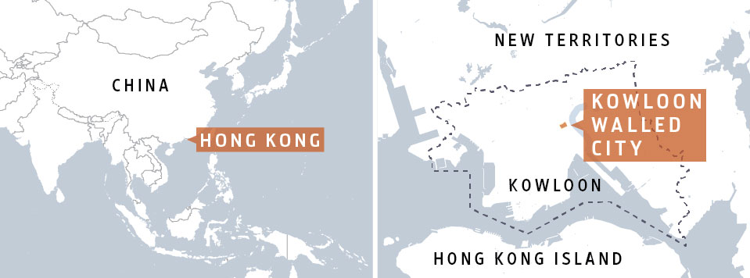
Kowloon Walled City

Slide 14
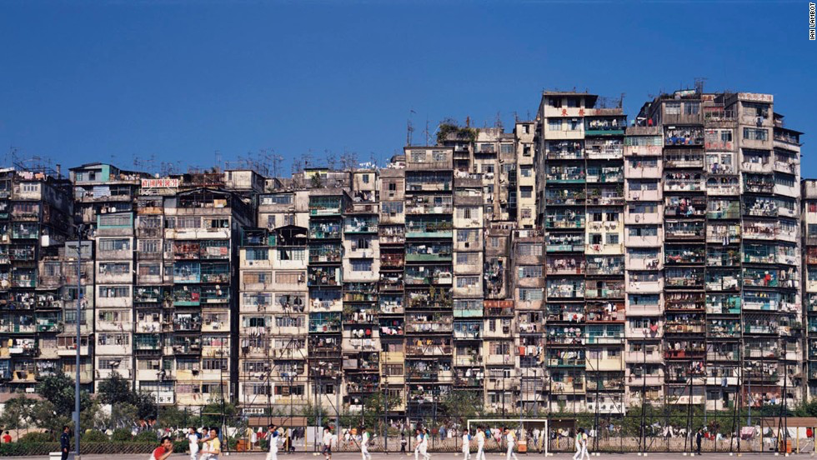
Kowloon Walled City
14 stories
33,000 people
8,000 homes
1,000 business
2.8 hectares
Notes:
Tell students the settlement may have been even larger if the nearby airport did not limit the height to 14 stories.

Slide 15
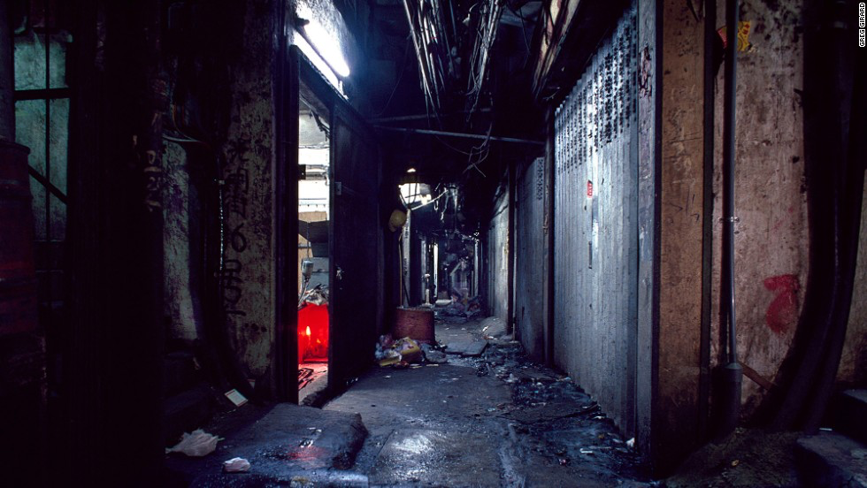
Would you move here?
Notes:
While it may not look like an ideal environment, the city was unique in that it was a Chinese territory located within the borders of then British colony, Hong Kong. The Chinese and the British governments both tended to leave this particular area alone when it came to law enforcement. While this made the region notorious for criminal activities, it was also much easier for families to start businesses, especially refugees escaping the leadership Mao Zedong’s Communist Party in nearby China.

Slide 16
Why do people migrate?
Push factors are the reasons why people leave an area. They include:
Lack of services
Lack of safety
Crop failure / drought / flooding
Poverty
War
Pull factors are the reasons why people move to a particular area. They include:
Higher employment
More wealth
Better services
Safer, less crime
Political stability
More fertile land

Slide 17
People of Kowloon Gallery Walk
Answer the following questions for each image:
What attracts people to Kowloon? [pull factors]
Why are people moving away from their previous homes [push factors]
Notes:
The next five slides contain stories of five different residents of Kowloon Walled City. Using a gallery walk print out copies of slides 16 through 20 and display them on the walls around the room.

Slide 18
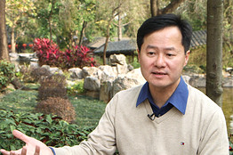
Lived inside: 1979-1992
Albert Ng Kam-po went to school outside the Walled City but remembers playing on its rooftop and in its corridors. Born during the Cultural Revolution, he and his family migrated from the city of Chiu Chow in southern China to join his Thai-born Chinese father in Hong Kong. They instantly belonged to the Walled City’s strong Chiu Chow community.

Slide 19
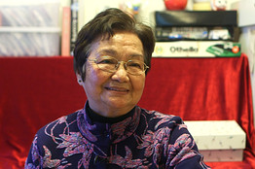
Lived inside: 1959 - 1981
A mother of nine, Yeung Lai-wan became a hawker* when her husband lost his job as a chef following the stock-market crash. To survive, they sold dim sum – Cantonese small bites often accompanied by tea – out of a wooden street cart outside the Walled City. The family moved away after their home’s poor air quality affected Mrs. Yeung’s health.
*hawker: a person who travels around selling goods, typically advertising them by shouting.

Slide 20
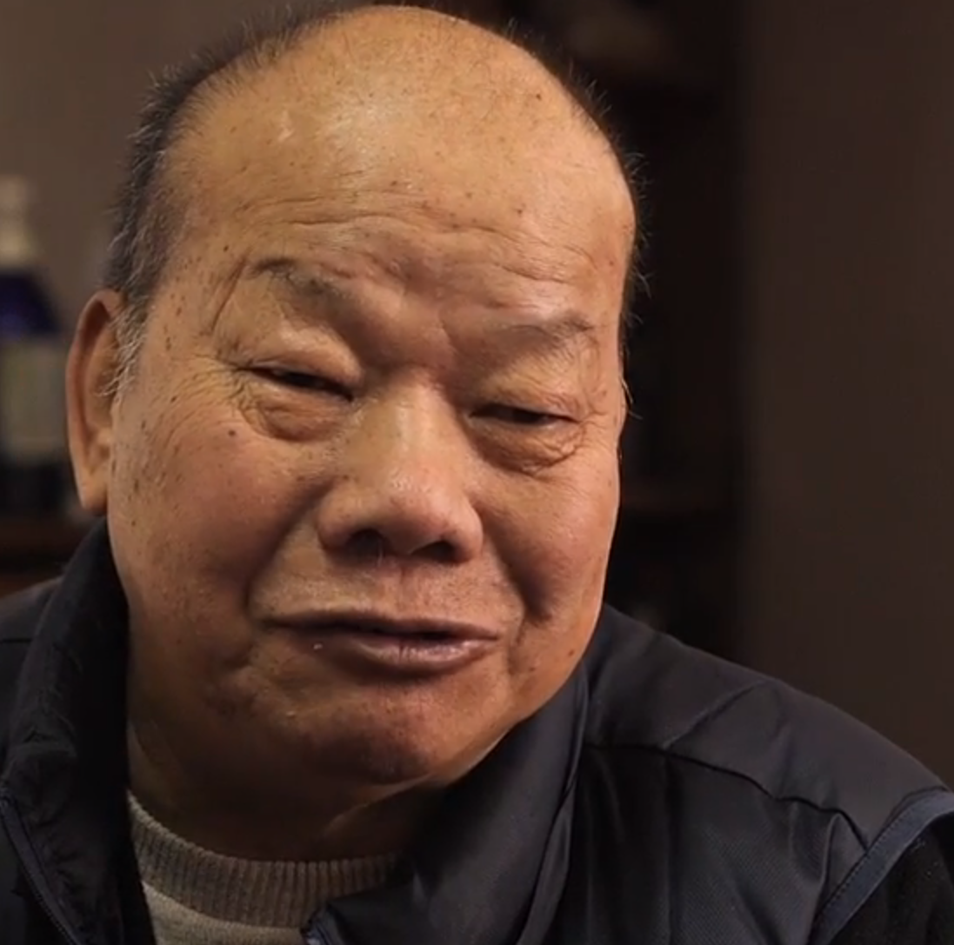
Lived inside: 1948 - 1979
Paul Tang Kam-cheung was a teenager when he joined the Hong Fat Shan triad gang – later known as the 14K – in the 1950s. The gang’s activities included narcotic trafficking, illegal gambling, and operating strip clubs and brothels. Mr. Tang became a heroin addict and did jail time for robbery and drugs. He moved out of the Walled City after converting to Christianity and becoming a pastor.

Slide 21
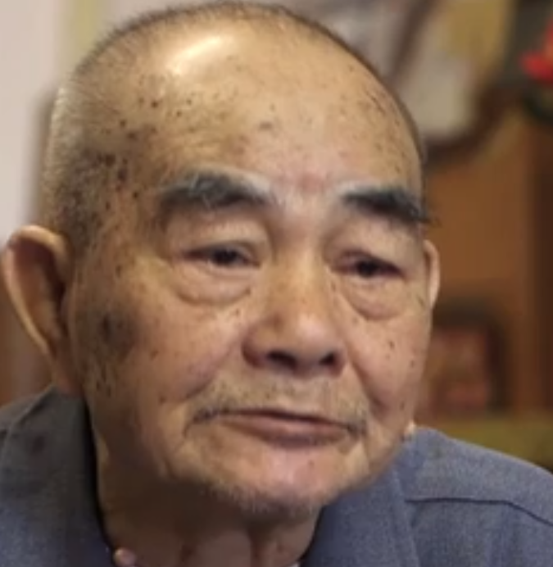
Lived inside 1972-1983
Lore* had it that 80% of Hong Kong’s fishballs — the territory’s ultimate gourmet delicacy — were produced inside the Walled City. Wong Yum-fai supplied fishballs and fishcakes to wholesale markets. He was eventually able to open a noodle show below his apartment unit. When his children were old enough, they helped out with the family business.
*Lore: knowledge on a subject typically passed from person to person by word of mouth.

Slide 22
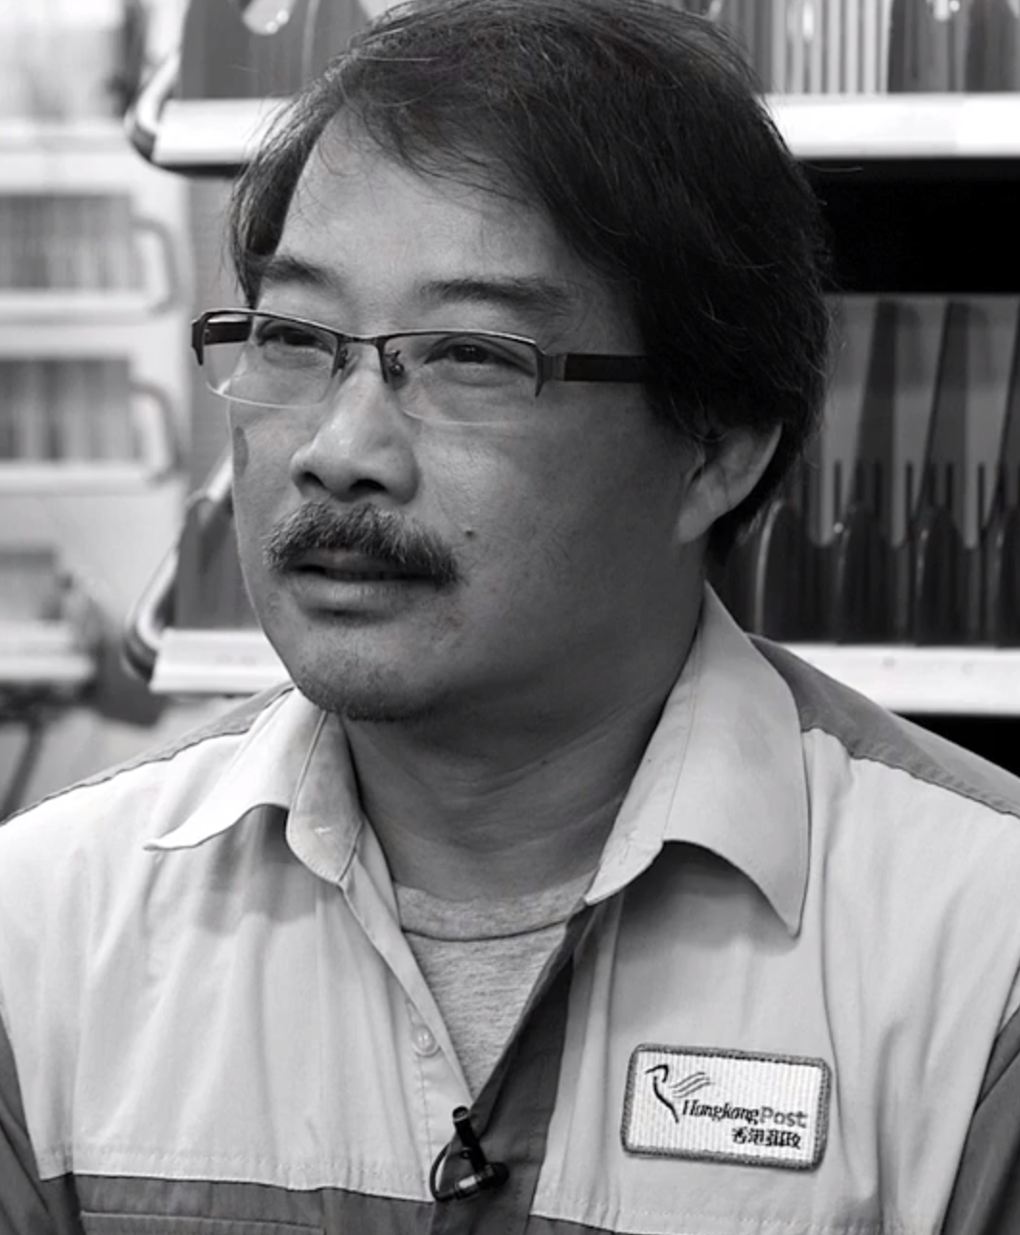
Worked inside 1979 - 1991
Lam Po-chun was 18 when he began delivering mail inside the Walled City. The area’s only other postman, Mr. Lam’s mentor, recruited him for his “bad boy” personality, which allowed him to think flexibly – essential for mastering the chaotic numbering system.

Slide 23
Final Thoughts
While the Kowloon Walled City (demolished in 1994) lacked room to the point of being inhumane, many residents did not want to leave their homes.
Is it possible to have a similar quality of life in such different physical spaces?
What role did physical space play as a push/pull factor for residents in Kowloon?

